Slide 1

Welsh Nursing Care Record
DHCW Board Presentation:
Date of Board: 25th November 2021
Name of presenter: Fran Beadle/Judith Bowen
National Clinical Informatics Lead Nursing/ Informatics Lead Nurse Hywel Dda

Slide 2

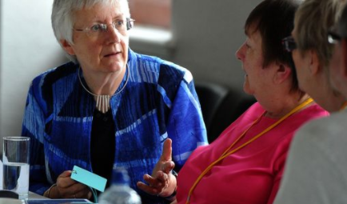


Welsh Nursing Care Record | Why Nursing Documentation ?
Poor Nursing documentation ​
Lack of standardisation ​
Manual auditing ​
Duplication of documentation​
Repetitive questioning ​
Notes:
Why Nursing Documentation ?
Poor Nursing documentation illustrated in ​
Health Inspectorate reports ​
Andrews Report Trusted to Care 2014​
Flynn report 2015​
Lack of standardisation ​
Manual auditing ​
Duplication of documentation​
Repetitive questioning ​

Slide 3
Welsh Nursing Care Record | Why Nursing Documentation ?
“Nurses, midwives and multi professional team members are confident and competent with using the WNCR.
They utilise the data from the WNCR to drive improvements and learning across organisations in Health and Care in Wales, improving patient outcomes and experiences. Patients receive seamless care and patients and staff can move across services in Wales using the single WNCR system.”

Slide 4



Welsh Nursing Care Record | What is the aim?
Notes:
Standardise Nursing Documentation
Increase patient Safety
Reduce Repetitive Questioning and Duplication
Reduce the documentation burden on nursing
Document once reuse many times
Automate audit data collection

Slide 5

Welsh Nursing Care Record | Main constraints/risks/issues to success
Notes:
FUNDING
TECHNICAL CONSTRAINTS (Initial decisions)
PEOPLE
USER ACCEPTANCE
BUSINESS CHANGE

Slide 6


Welsh Nursing Care Record | What were our key lessons good and bad?
Notes:
Good
Clinical Engagement
Defining priorities
Listening to the user
Business transformation team
Extensive engagement
Aspects that could be improved
Interoperability to ensure smooth patient pathways & Professional accountability
Service management 24/7
Communication with other programmes WPAS

Slide 7
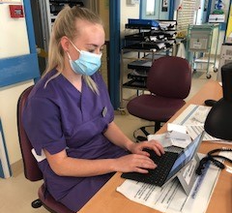



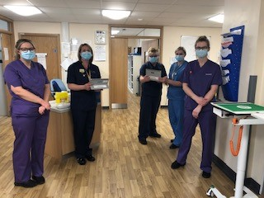

Welsh Nursing Care Record | Outcomes
Notes:
USER ACCEPTANCE
Nurses at the bedside
Reduced carbon foot print
cost savings
Increase patient safety
Standardisation
Proud Nursing staff and managers

Slide 8


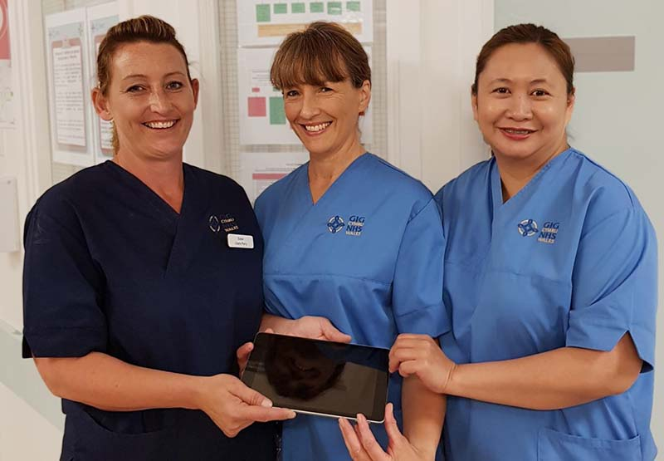
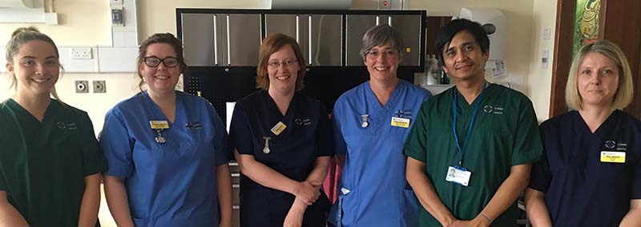
Welsh Nursing Care Record | The User Experience

Slide 9

Welsh Nursing Care Record | Summary
How did we do?
  Exceeded expectations achieving national standardisation,
What learning did we have?
  Effective National and Local Collaborative Clinical & Technical MDT Project Team working
How are we sharing that with others?
  WNCR evaluation – local HB, national * International communications and presentations
  Influencing additional local and national applications with lessons learned
What are we doing to make sure successes are copied?
  Sharing lessons learnt with other programmes, welsh government and health boards
  Formal evaluation and lessons learnt documents

Slide 10
Diolch
Thank you

