Slide 1
The Board Assurance Report Dashboard

Slide 2
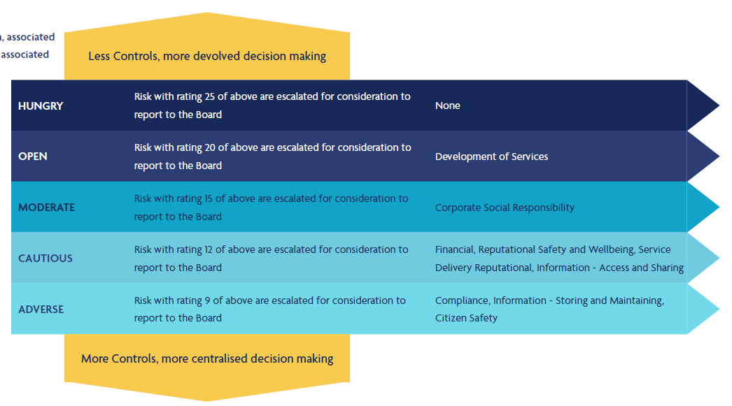
DHCW Risk appetite statement and tolerances
DHCW RISK APPETITE
DHCW must take risks to achieve its strategic aims and deliver beneficial outcomes to stakeholders
Risks will be taken in a considered and controlled manner
Exposure to risks will be kept to a level of impact deemed acceptable by the Board
The acceptable level may vary from time to time and will therefore be subject to at least annual review and revision
Any risk outside our agreed appetite may be accepted and will be subject to a governance process to ensure visibility and management
Some particular risks above the agreed risk appetite may be accepted because:
  the likelihood of them occurring is deemed to be sufficiently low
  they have the potential to enable realisation of considerable reward/benefit
  they are considered too costly to control given other priorities
  the cost of controlling them would be greater than the cost of the impact should they materialise
  there is only a short period of exposure to them
  mitigating action is required by an external party

Slide 3
Principal risk summary
The Principal risk summary gives an overview of the Principal risk in relation to each of the DHCW strategic objectives and the rationale for the scoring.
Type | Detail | Current risk score and rationale | Current risk score and rationale | Target risk score and rationale
OBJ | 1. Enabling Digital Transformation supporting joined up, consistent care
PR | IF we do not co-design safe and secure services with users supported by common standards and collaborative ways of working THEN our development may not meet user needs RESULTING IN not being able to digitally transform services at pace | 16 - 4 (Likely) x 4 (Major) This risk score is derived from our analysis of systems as part of developing new strategies over the last twelve months. | 16 - 4 (Likely) x 4 (Major) This risk score is derived from our analysis of systems as part of developing new strategies over the last twelve months. | 4 – 1 (Rare) x 4 (Major) Each of our strategies addresses complexity and silos through a commitment to standards based open architecture, which is intended to streamline and simplify our systems and delivery interoperability.
OBJ | 2. Delivering high quality technology, data products and services to support efficiencies and improvements in care processes
PR | IF we do not deliver safe, secure, accessible, resilient products and services of high quality THEN the ability of health and care partners to deliver and modernise services is compromised RESULTING IN less effective, less sustainable care that could cause harm and would not meet the expectations of patients or professionals. | 9 - 3 (Possible) x 3 (Moderate) Established operational support is in place and work has been undertaken in recent years to improve the availability and security of the services, but further action is needed to ensure resilience and security is at the required level. | 9 - 3 (Possible) x 3 (Moderate) Established operational support is in place and work has been undertaken in recent years to improve the availability and security of the services, but further action is needed to ensure resilience and security is at the required level. | 4 – 2 (Unlikely) x 2 (Minor) There are clearly articulated plans for the activity required to increase the resilience and security of the system which should reduce the risk to an acceptable level with careful scrutiny and monitoring.
OBJ | 3. Expanding the content, availability and functionality of the digital health and care record so that care and treatment quality is improved
PR | IF we fail to expand the content, availability and functionality of the Digital Health and Care Record at the required pace THEN information could be incomplete, inconsistent, or held in different places RESULTING IN a reduced ability to use information to inform care and empower citizens, leading to better outcomes. | 12 – 3 (Possible) x 4 (Major) The digital health and care record has developed over recent years, but we know this expansion must continue at pace to ensure that patients and clinicians have the best possible information to support the achievement of high quality care outcomes. | 12 – 3 (Possible) x 4 (Major) The digital health and care record has developed over recent years, but we know this expansion must continue at pace to ensure that patients and clinicians have the best possible information to support the achievement of high quality care outcomes. | 6 – 2 (Unlikely) x 3 (Moderate) The new NDR strategy has set out a clear and prioritised road map for the single health record along side development in digital services such as WCP and WNCR. We will continue to explore enhanced functionality supporting use cases in the strategy and using AI.
OBJ | 4. Driving Value and innovation for better outcomes and value based care
PR | IF we do not focus on making use of data and innovation to improve outcomes THEN we may not be optimising value for citizens RESULTING IN less sustainable health and care services and reduced or delayed benefit for the public and patients. | 16 – 4 (Likely) x 4 (Major) Fragmented approaches to driving value from data may result in lost opportunities to innovate, enhance operational delivery and improve health and care outcomes. | 16 – 4 (Likely) x 4 (Major) Fragmented approaches to driving value from data may result in lost opportunities to innovate, enhance operational delivery and improve health and care outcomes. | 12 – 3 (Possible) x 4 (Major) A best practice approach and operating model to sharing data for operational delivery, research and innovation.
OBJ | 5. Becoming the trusted strategic partner and a high performing, inclusive, ambitious organisation supporting our workforce and stakeholders
PR | IF we do not become a trusted partner and a high performing inclusive organisation THEN people will not want to work with and for us RESULTING IN a failure to achieve our strategic ambition of delivering world leading digital services. | 15 – 3 (Possible) x 5 (Catastrophic) As a new organisation the initial risk score reflects the work still to do in terms of continuing to be a learning organisation which will support recruitment and retention of staff as well as working collaboratively with partner organisations . This includes the implementation of the DHCW organisational structure and approach across the organisation. |  | 5 - 1 (Rare) x 5 (Catastrophic) There are multiple activities that contribute to the delivery of the strategic objective and these include a focus on the digital workforce, recruiting and retaining the best talent, being organised in the most efficient and effective way, as well as working in a high trust environment with partners to enable digital transformation.

Slide 4
Principal risk heat map
Progress Report
The planned activity for the principal risks is for action April 22 – March 23 with aim to move towards or achieve the target risk score by then. The report will be presented to the SHA Board in May and November each year, it will provide a self assessment RAG status from the objective/mission owner to indicate the current areas of concern. Additionally it will give an overview of progress on the action plans to address any gaps and will provide narrative as to the trajectory of the principal risks. Starting points for each risk are shown by numbers corresponding to the objective/mission in the heat map to the right, in future reports changes in score will be indicated through movement along the black line. Should a risk increase in score this will be highlighted by a dotted line and the number will be moved to that space.
Questions to ask yourself: Is the progress of the action plans later in the report sufficient to achieve the target score? Are you satisfied the principal risks are still accurate and reflective with reference to the delivery of the strategic objectives?
Residual Principal Risk Severity Map (showing direction of travel to target)
 |  | LIKELIHOOD
 |  | RARE (1) | UNLIKELY (2) | POSSIBLE (3) | LIKELY (4) | ALMOST CERTAIN (5)
CONSEQUENCES | CATASTROPHIC (5)
 | MAJOR (4)
 | MODERATE (3)
 | MINOR (2)
 | NEGLIGIBLE (1)
Strategic Principal Risk Impact Statement
Should any of the strategic risks being realised the consequence would include potential of harm to patients, impacts on the working conditions of staff, poor quality service, failure to achieve the required digital transformation at pace, potential litigation at both a corporate and personal level with financial and/or penal sanctions and/or significant reputational damage which could threaten the future of the organisation and it’s success.
5
3
4
1
2

Slide 5
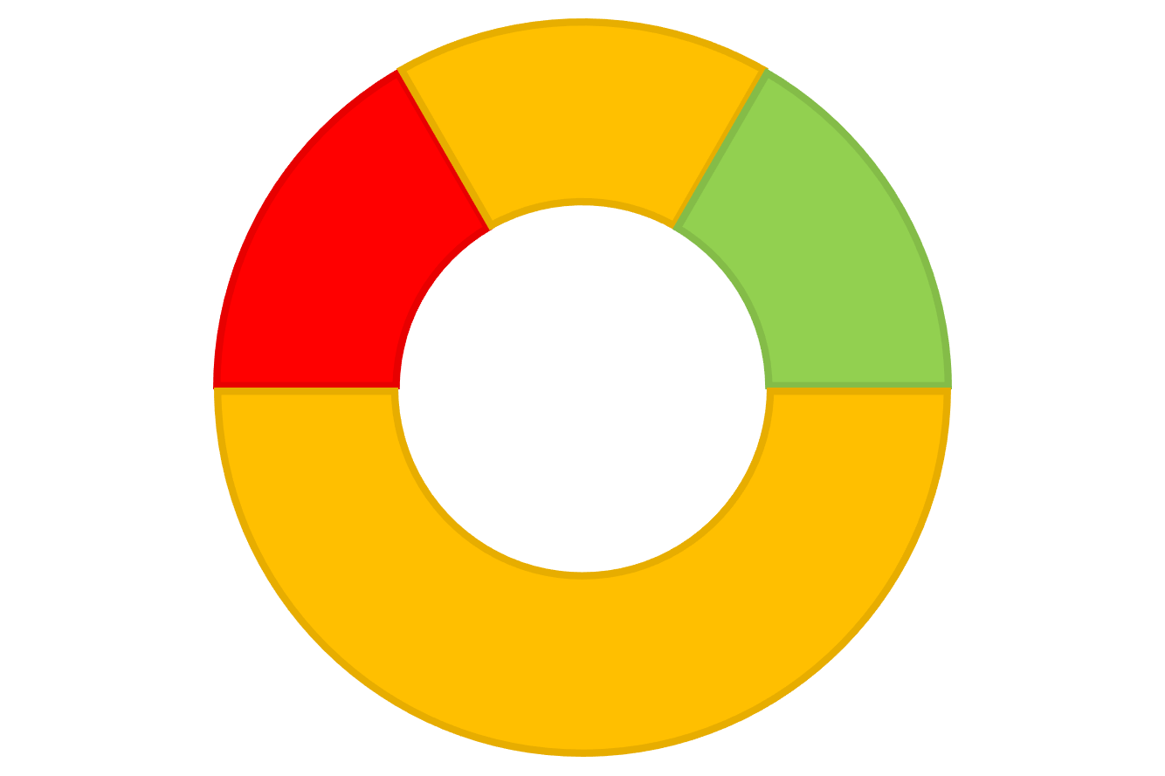
Assurance Summary
Key – Control and assurance RAG Rating | LOW NUMBER OF CONTROLS IN PLACE | Significant concerns over the adequacy/effectiveness of the controls in place in proportion to the risks
 | MEDIUM NUMBER OF CONTROLS IN PLACE | Some areas of concern over the adequacy/effectiveness of the controls in place in proportion to the risks
 | HIGH NUMBER OF CONTROLS IN PLACE | Controls in place assessed as adequate/effective and in proportion to the risk
 | INSUFFICIENT DATA TO PROVIDE A RAG | Insufficient information at present to judge the adequacy/effectiveness of the controls
Type | Detail | Associated risk impact domain |  | Risk Appetite | Risk Appetite rationale/likely scenario | Assurance Self- Assessment
M | 1. Enabling digital transformation supporting joined up, consistent care | Reputational Development of services Information – Access and Sharing Information – Storing and maintaining | Financial Service Delivery Patient/Citizen Safety Corporate Social Responsibility | CAUTIOUS | DHCW will accept a small amount of risk in ensuring compliance with information governance, information security and cyber security. We will manage the associated corporate risks at their appetite levels to protect against the potential consequences.
PR | IF we do not co-design safe and secure services with users supported by common standards and collaborative ways of working THEN our development may not meet user needs RESULTING IN not being able to digitally transform services at pace | Reputational Development of services Information – Access and Sharing | Financial Service Delivery Patient/Citizen Safety Corporate Social Responsibility
M | 2. Delivering high quality technology, data products and services to support efficiencies and improvements in care processes | Patient/Citizen Safety Development of services Service Delivery | Financial Information – Access and Sharing Compliance | CAUTIOUS | DHCW will accept a small amount of risk in the provision of secure and resilient high quality digital services. Where we are developing services we will take more risks.
PR | IF we do not deliver safe, secure, accessible, resilient products and services of high quality THEN the ability of health and care partners to deliver and modernise services is compromised RESULTING IN less effective, less sustainable care that could cause harm and would not meet the expectations of patients or professionals. | Patient/Citizen Safety Development of services | Financial Information – Access and Sharing Compliance
M | 3. Expanding the content, availability and functionality of the digital health and care record so that care and treatment quality is improved | Reputational Patient/Citizen Safety Development of services Service Delivery | Financial Corporate Social Responsibility Compliance | MODERATE | DHCW will accept a moderate amount of risk to deliver successful expansion of the digital health and care record with input from users. We will carefully manage the associated corporate risks with a focus on prioritising any patient/citizen safety risk concerns.
PR | IF we fail to expand the content, availability and functionality of the Digital Health and Care Record at the required pace THEN information could be incomplete, inconsistent, or held in different places RESULTING IN a reduced ability to use information to inform care and empower citizens, leading to better outcomes.
M | 4. Driving value and innovation for better outcomes and value based care | Reputational Information – Access and Sharing | Development of services | OPEN | DHCW will accept risks in the pursuit of driving innovation to achieve better value evidenced by improved outcomes.
PR | IF we do not focus on making use of data and innovation to improve outcomes THEN we may not be optimising value for citizens RESULTING IN less sustainable health and care services and reduced or delayed benefit for the public and patients.
M | 5. Becoming the trusted strategic partner and a high performing, inclusive, ambitious organisation supporting our workforce and stakeholders | Reputational Safety and Wellbeing | Corporate Social Responsibility Compliance | MODERATE | DHCW will accept a moderate amount of risk in the pursuit of becoming recognised as a trusted partner and a high performing inclusive organisation.
PR | IF we do not become a trusted partner and a high performing inclusive organisation THEN people will not want to work with and for us RESULTING IN a failure to achieve our strategic ambition of delivering world leading digital services.

Slide 6
MISSION 1: Enabling Digital Transformation supporting joined up, consistent care |  |  |  |  |  |  | RAG STATUS: AMBER Some areas of concern over the adequacy/effectiveness of the controls in place in proportion to the risks
EXECUTIVE OWNER: Director of Strategy |  |  | RISK APPETITE: CAUTIOUS
REPORTING PERIOD: 1ST April – 30th June 2022 |  |  | DATE OF REVIEW: 01st July 2022 |  |  |  |  | SELF ASSESSMENT ASSURANCE RATING |  |  | KEY CONTROLS |  | ASSURANCE
RISKS | PRINCIPAL RISK 1 |  |  |  |  |  |  |  |  | CURRENT SCORE |  | TARGET SCORE
CORPORATE RISKS | IF we do not co-design safe and secure services with users supported by common standards and collaborative ways of working THEN our development may not meet user needs RESULTING IN not being able to digitally transform services at pace |  |  |  |  |  |  |  |  | 16/25 4 (Likely) x 4 (Major) |  | 4/25 1 (Rare) x 4 (Major)
 | ASSOCIATED CORPORATE RISK/S |  |  |  | Risk Key:
 |  |  |  |  | CURRENT SCORE |  |  | TARGET SCORE
 | 0264 – Data Promise |  |  |  | 4x3 = 12/25 |  |  | 1x4 = 4/25
 | 0290 – Digital Supplier Contracts Increased |  |  |  | 4x4 – 16/25 |  |  | 1x3 = 6/25
CONTROLS AND ASSURANCE | KEY CONTROLS GAPS | ACTION PLAN | ASSURANCE GAPS | ASSURANCE GAPS |  | ACTION PLAN | ACTION PLAN | PROGRESS ON ACTION PLAN – NARRATIVE PROVIDED BY EXECUTIVE OWNER | PROGRESS ON ACTION PLAN – NARRATIVE PROVIDED BY EXECUTIVE OWNER | PROGRESS ON ACTION PLAN – NARRATIVE PROVIDED BY EXECUTIVE OWNER
 | Open Architecture Strategy - need to develop implementation plan NDR Data Strategy - develop an implementation plan Cloud strategy - develop an implementation plan National rulebook for accessing open architecture Data Promise (1) need to support the development of the strategy; (2) need to support the implementation plan Information Asset Register (1) Finalise and close project and move to business as usual. | Approval of the Open Architecture Implementation plan by SHA Board Identify ownership of the ‘Asset Register’ Work with Welsh Government to define requirements and approach for data promise Create an implementation plan for the NDR data strategy Create an implementation plan for the cloud strategy Create a national rulebook for accessing open architecture and seek approval from the SHA Board. | Lack of assurance for standardised methods of clinical input for the development of data standards Lack of operational reporting on standardised methods of clinical input for the development of data standards Lack of reporting on the compliance with the national data standards framework Lack of reporting on the organisational compliance with the open architecture strategy Lack of reporting on the organisational compliance with the NDR data strategy Lack of reporting on the organisational compliance with the Cloud strategy | Lack of organisational reporting on the compliance with the national data standards Lack of reporting on the delivery of the implementation plans as a result of approval of the NDR data strategy Lack of reporting on the organisational compliance with the Cloud strategy Lack of reporting on the effective implementation of the national rulebook for accessing open architecture Routine reporting to monitor the health of the Information Asset Register. |  | Create a method for monitoring compliance with the agreed standards with reporting to operational and assurance arenas Create DHCW compliance reporting against the NDR data strategy delivery plan Create DHCW compliance reporting against the Cloud strategy Create progress reporting on the effectiveness of the national rulebook. | Create effectiveness review of the methods used to capture clinical input on data standards to be reported at an operational and assurance level Create DHCW compliance reporting against the national data standards framework, provide assurance reporting via Committee Create DHCW compliance reporting against the open architecture strategy, provide assurance reporting via the Committee Create DHCW compliance reporting against the NDR data strategy Create DHCW compliance reporting against the Cloud strategy
Amber
Amber
There is a phased plan to address control gaps and then develop reporting which will address related assurance gaps.
Strategic roadmaps have been developed for elements of the Open Architecture and as part of the NDR Data Strategy.
APIS will provide access to elements of the Open Architecture and the first of these will be available during Q2.
The rulebook will authorise access to APIs and will follow by Q4.
An implementation plan is being developed alongside work on developing our product approach and is due by Q3 2022.
Good progress made on establishing Information Asset Registers during the period.
WG continued to work on the data promise, with support and input from the DHCW IG team.

Slide 7
MISSION 2: Delivering high quality technology, data products and services to support efficiencies and improvements in care processes |  |  |  |  |  |  |  | RAG STATUS: AMBER Some areas of concern over the adequacy/effectiveness of the controls in place in proportion to the risks
EXECUTIVE OWNER: Director of Operations |  |  | RISK APPETITE: CAUTIOUS
 |  |  |  |  |  |  |  |  |  |  | SELF ASSESSMENT ASSURANCE RATING | KEY CONTROLS |  | ASSURANCE
REPORTING PERIOD: 1ST April – 30th June 2022 |  |  | DATE OF REVIEW: 01st July 2022
RISKS | PRINCIPAL RISK 2 |  |  |  |  |  |  |  |  |  | CURRENT SCORE |  | TARGET SCORE
CORPORATE RISKS | IF we do not deliver safe, secure, accessible, resilient products and services of high quality THEN the ability of health and care partners to deliver and modernise services is compromised RESULTING IN less effective, less sustainable care that could cause harm and would not meet the expectations of patients or professionals. |  |  |  |  |  |  |  |  |  | 9/25 3 (Possible) x 3 (Moderate) |  | 4/25 2 (Unlikely) x 2 (Minor)
 | ASSOCIATED CORPORATE RISK/S |  |  |  | CURRENT SCORE | Risk Key:
 | RISK REFERENCE |  | CURRENT SCORE | CURRENT SCORE | TARGET SCORE | RISK REFERENCE |  |  |  | CURRENT SCORE | TARGET SCORE | TARGET SCORE
 | 0228 – Fault Domains |  | 4x3 = 12/25 | 4x3 = 12/25 | 3x2 = 6/25 | **0280 – PRIVATE |  |  |  | 5X3 = 15/25 |  | 2X5 = 10/25
 | **0229 - PRIVATE |  | 3x4 = 12/25 | 3x4 = 12/25 | 3x2 = 6/25 | **0281 – PRIVATE |  |  |  | 3X5 = 15/25 |  | 2X3 = 6/25
 | **0257 – PRIVATE |  | 5X3 = 15/25 | 5X3 = 15/25 | 5X2 = 10/25 | **0282 - PRIVATE |  |  |  | 3X5 = 15/25 |  | 2X5 = 10/25
 | **0277 - PRIVATE |  | 5x3 = 15/25 | 5x3 = 15/25 | 2x5 = 10/25 | **0286 – PRIVATE |  |  |  | 3x4 = 12/25 |  | 2x4 = 8/25
 | 0289 – Digital Inflation |  |  | 4x4 = 16/25 | 3x4 = 12/25 | 0291 – Network Equipment delays – DC 2 |  |  |  | 4x4 = 16/25 |  | 3x3 = 9/25
 | **0278 - PRIVATE |  |  | 5X3 = 15/25 | 2X5 = 10/25 | 0292 – Insufficient human resource infrastructure capacity |  |  |  | 4x4 = 16/25 |  | 4x2 = 8/25
 | **0279 – PRIVATE |  |  | 5X3 = 15/25 | 2X5 = 10/25
CONTROLS AND ASSURANCE | KEY CONTROLS GAPS | ACTION PLAN |  |  | ASSURANCE GAPS |  | ACTION PLAN |  | PROGRESS ON ACTION PLAN – NARRATIVE PROVIDED BY EXECUTIVE OWNER
 | (User experience): (1) need to more consistently embed feedback on user centred design; (2) No systemic and routine implementation of the feedback across all services. Product Approach: (1) define implementation plan | Introduce User Experience Involvement Group; group to oversee implementation of the strategy ensuring consideration of feedback at every level |  |  | Lack of assurance for widespread user experience on the range of systems |  | Provide effectiveness reporting to the Product Owner, Senior Management Team and assurance reporting on how user feedback is being considered
Amber
Amber
Product approach high-level plan developed and presented to Management Board in June 2022
Product approach discussion held at Board Development on 30 June 2022.
Further directorate planning on 12 July 2022 in conjunction with Strategy to confirm product structure recommendations and technical approach for the remainder of this year and forecasting for 2023.

Slide 8
MISSION 3: Expanding the content, availability and functionality of the digital health and care record so that care and treatment quality is improved |  |  |  |  |  |  | RAG STATUS: AMBER Some areas of concern over the adequacy/effectiveness of the controls in place in proportion to the risks
EXECUTIVE OWNER: Director of Strategy |  |  | RISK APPETITE: MODERATE
 |  |  |  |  |  |  |  |  | SELF ASSESSMENT ASSURANCE RATING |  | KEY CONTROLS |  | ASSURANCE
REPORTING PERIOD: 1ST April – 30st June 2022 |  |  | DATE OF REVIEW: 01st July 2022
RISKS | PRINCIPAL RISK 3 |  |  |  |  |  |  |  |  | CURRENT SCORE |  | TARGET SCORE
CORPORATE RISKS | IF we fail to expand the content, availability and functionality of the Digital Health and Care Record at the required pace THEN local solutions could be sought RESULTING IN disparate data stored outside the single record and potential impact on system wide digital transformation and patient care. |  |  |  |  |  |  |  |  | 12 /25 3 (Possible) x 4 (Major) |  | 6 /25 2 (Unlikely) x 3 (Moderate)
 | ASSOCIATED CORPORATE RISK/S |  |  | CURRENT SCORE | Risk Key:
 |  |  |  |  | CURRENT SCORE |  |  |  | TARGET SCORE
 | 0204 – Canisc System |  |  |  | 5X4 =20/25 |  |  |  | 3X2 = 6/25
CONTROLS AND ASSURANCE | KEY CONTROLS GAPS | ACTION PLAN |  | ASSURANCE GAPS |  | ACTION PLAN |  | PROGRESS ON ACTION PLAN – NARRATIVE PROVIDED BY EXECUTIVE OWNER
 | User experience: (1) need to more consistently embed feedback on user centred design; (2) Create systemic and routine implementation of the feedback across all services. Clinical Feedback: (1) Need to formalise the mechanism for gaining more sophisticated understanding of clinical user need;(2) Continuous feedback from clinical users on the extent to which how digital is supporting joined up consistent care | Introduce User Experience Involvement Working Group; group to oversee implementation of new systems on the patient experience ensuring consideration of feedback at every level Create and seek approval for the clinical user feedback approach |  | Reporting of structured feedback on services and systems at a Directorate and organisational level |  | Create consistent approach to gathering feedback including establishing user groups to provide feedback Include learning and action from feedback into the assurance reporting to the relevant Committee
Amber
Amber
Directors are reviewing existing arrangements for user input, including service desk feedback, clinical engagement, clinical informatics.
Directors are considering options for an User Design team and/or profession within DHCW. If viable and affordable this would provide more assurance than an User Experience Involvement Working Group.
The strategic approach will be confirmed during Q2.

Slide 9
MISSION 4: Driving Value and innovation for better outcomes and value based care |  |  |  |  |  |  | RAG STATUS: AMBER Some areas of concern over the adequacy/effectiveness of the controls in place in proportion to the risks
EXECUTIVE OWNER: Medical Director |  |  | RISK APPETITE: OPEN
 |  |  |  |  |  |  |  |  | SELF ASSESSMENT ASSURANCE RATING | KEY CONTROLS |  | ASSURANCE
REPORTING PERIOD: 1ST April – 30st June 2022 |  |  | DATE OF REVIEW: 01st July 2022
RISKS | PRINCIPAL RISK 4 |  |  |  |  |  |  |  | CURRENT SCORE |  | TARGET SCORE
CORPORATE RISKS | IF we do not focus on making use of data and innovation to improve outcomes THEN we may not be optimising value for citizens RESULTING IN less sustainable health and care services and reduced or delayed benefit for the public and patients. |  |  |  |  |  |  |  | 16/25 4 (Likely) x 4 (Major) |  | 12/25 3 (Possible) x 4 (Major)
 | ASSOCIATED CORPORATE RISK/S |  |  | CURRENT SCORE | Risk Key:
 |  |  |  |  | CURRENT SCORE |  |  |  | TARGET SCORE
 | 0269 – Switching Service |  |  |  | 4x4 = 16/25 |  |  |  | 3x2=6/25
 | 0263 – DHCW Functions |  |  |  | 4x3 = 12/25 |  |  |  | 4x1 = 4/25
CONTROLS AND ASSURANCE | KEY CONTROLS GAPS | ACTION PLAN |  | ASSURANCE GAPS |  | ACTION PLAN | ACTION PLAN | PROGRESS ON ACTION PLAN – NARRATIVE PROVIDED BY EXECUTIVE OWNER
 | Research and Innovation Strategy (1) need to develop the strategy; (2) need to develop implementation plan Not having clarity on DHCW Functions to process data to drive value and innovation. | Research and Innovation Strategy to be completed for sign off by the DHCW SHA Board Work with Welsh Government to define DHCW’s functions based on the data promise. |  | Reporting on progress of implementation of the Research and Innovation Strategy Reporting on compliance with DHCW’s functions to process data to drive value and innovation. |  | Create routine reporting for the Information Asset Register both operationally and to the relevant Committee Create reporting mechanisms for the R&I strategy both operationally and to the relevant Committee Create a reporting mechanism for compliance with DHCW’s functions for processing data once these are clearly defined. | Create routine reporting for the Information Asset Register both operationally and to the relevant Committee Create reporting mechanisms for the strategy both operationally and to the relevant Committee Create a reporting mechanism for compliance with the data promise both operationally and to the relevant Committee
Amber
Amber
Continued discussions with Welsh Government colleagues to define the parameters of the DHCW functions during the quarter.
Work on developing the R&I Strategy continues.
R&I Strategy updated provided to the DG&S Committee in May 2022 and further update planned for August 2022
TensTalk provided on the emerging R&I Strategy on 12 July to update the organisation.

Slide 10
MISSION 5: Becoming the trusted strategic partner and a high performing, inclusive, ambitious organisation supporting our workforce and stakeholders |  |  |  |  |  |  |  | RAG STATUS: AMBER Some areas of concern over the adequacy/effectiveness of the controls in place in proportion to the risks
EXECUTIVE OWNER: Director of Finance/Deputy CEO |  |  |  | RISK APPETITE: MODERATE
 |  |  |  |  |  |  |  |  |  | SELF ASSESSMENT ASSURANCE RATING |  |  | KEY CONTROLS |  |  | ASSURANCE
REPORTING PERIOD: 1st April – 30th June 2022 |  |  |  | DATE OF REVIEW: 1st July 2022
RISKS | PRINCIPAL RISK 5 |  |  |  |  |  |  |  | CURRENT SCORE |  |  |  |  | TARGET SCORE
CORPORATE RISKS | IF we do not become a trusted partner and a high performing inclusive organisation THEN people will not want to work with and for us RESULTING IN a failure to achieve our strategic ambition of delivering world leading digital services. |  |  |  |  |  |  |  | 15/25 3 (Possible) x 5 (Catastrophic) |  |  |  |  | 5/25 1 (Rare) x 5 (Catastrophic)
 | ASSOCIATED CORPORATE RISK/S |  |  |  | CURRENT SCORE | Risk Key:
 | RISK REF |  | CURRENT SCORE | CURRENT SCORE | TARGET SCORE | RISK REF |  |  |  | CURRENT SCORE |  | CURRENT SCORE | TARGET SCORE | TARGET SCORE | TARGET SCORE
 | 0259 – Staff Vacancies |  | 4X4 = 16/25 | 4X4 = 16/25 | 2X3 = 6/25 | 0237 - New requirements impact on resource and plan |  |  |  | 4x4 = 16/25 |  | 4x4 = 16/25 | 3x3 = 9/25 | 3x3 = 9/25 | 3x3 = 9/25
 | 0288 – Data Centre migration revenue funding |  | 4x4 = 16/25 | 4x4 = 16/25 | 2x4 = 8/25 | 0208 – Welsh Language Compliance |  |  |  | 3x4 = 12/25 |  | 3x4 = 12/25 | 1x4 =4/25 | 1x4 =4/25 | 1x4 =4/25
 | 0285 – Unfunded NI increase |  | 4x3 = 12/25 | 4x3 = 12/25 | 2x3 = 6/25 | 0284 – Increased Utility Costs Financial Pressures |  |  |  |  |  | 4x3 = 12/25 |  |  | 3x2 = 6/25
CONTROLS AND ASSURANCE | KEY CONTROLS GAPS | ACTION PLAN |  |  | ASSURANCE GAPS |  | ACTION PLAN | ACTION PLAN |  | PROGRESS ON ACTION PLAN | PROGRESS ON ACTION PLAN
 | DHCW ISO Internal audit plan Corporate succession plan to outline (initially) succession into the top three tiers Welsh Language Scheme - (1) finalise Scheme and seek Board sign off (2) Set up assurance activity to review compliance Communications strategy (1) finalise strategy and seek sign off (2) Create new KPI's to measure the impact People and OD Strategy (1) need to develop the strategy; (2) need to develop implementation plan Lack of assurance mechanism in relation to the effectiveness of the Long term financial strategy Commercial Strategy for using third parties to increase workforce capacity Organisational Values Review | Finalise ISO Internal audit plan for 22/23 Complete Corporate Succession Plan Consult on and Sign off Welsh Language Scheme Communications Task and finish group to review finalise strategy People and OD Strategy and implementation plan to be completed for sign off by the SHA Board Create Long-Term Financial strategy and associated plan Agree commercial strategy for using third parties to increase workforce capacity and implementation plan Undertake and review of the organisations values |  |  | Lack of assurance mechanism in relation to effectiveness of DHCW ISO Internal Audit plan Reporting on the progress of the succession plan Progress reporting on effectiveness of implementation of Communications strategy Lack of assurance mechanism in relation to the effectiveness of the Long term financial strategy Commercial Strategy for using third parties to increase workforce capacity Organisational Values Review Progress reporting on effectiveness of implementation of People and OD strategy Lack of assurance mechanism in relation to the effectiveness of the Health and Wellbeing group Lack of assurance mechanism in relation to effectiveness of Governance Assurance Framework Progress of implementation of stakeholder engagement plan |  | Create reporting parameters for DHCW ISO Internal Audit Plan Create regular review mechanisms for the Corporate Succession plan Create reporting on the Communications strategy both operational and assurance Create reporting on the Long-Term Financial strategy and associated plan Create a resourcing group to assess the effective use of the commercial strategy and establish next steps Undertake review and validation of the organisational values with the staff Create reporting on the People and OD strategy both operational and assurance Create reporting mechanism on activities of the H&WB group and feedback on activities Create reporting for GAF Create 6-monthly report on stakeholder engagement as part of the SHA IOPR | Create reporting parameters for DHCW ISO Internal Audit Plan Create regular review mechanisms for the Corporate Succession plan Create reporting on the implementation of the strategy to be included in the SHA Integrated Organisational Performance Report Create reporting on the implementation of the strategy to be included in the SHA Integrated Organisational Performance Report Create reporting mechanism on activities of the group and feedback on activities Create feedback form for training to capture participant confidence in their knowledge Create reporting parameters for Governance Assurance Framework Create 6-monthly report as part of the SHA Integrated Organisational Performance Report
Amber
Amber
People and OD Strategy drafted and discussed at Directors Strategic session in June 2022.
Commercial Workforce Resourcing T&F Group being established.
DHCW Welsh Language Scheme out to public consultation (1 July – 30 September 2022)
Long Term Financial Funding approach being developed and due to come back to Exec Team for discussion.
Communications T&F Report being finalised for discussion.
Digital Maturity matrix being explored as an all Wales NHS Digital metric.

